Slide 1
Agenda
Brief introduction to Kubernetes
Learn Kubernetes Networking concepts and how to use Azure Networking Services for Kubernetes apps through lab exercises

Slide 2
What is a container?
Traditional virtual machines = hardware virtualization
Containers = operating system (Kernel) virtualization
Application
VM
VM
VM
VM
Container
Container
Container
Container
App
App
App
OS
OS
OS
OS
Kernel
Hardware
Hardware
Large footprint
Slow to bootup
Poor utilization of computing resource
Ideal for long running tasks
Small footprint
Quick bring-up time
Portable
Better utilization of computing resource
Agile – ideal for running short-lived/ephemeral tasks (think Azure Functions, AWS Lambda)
Average lifetime of a container = 2.5 days, VM = 23 days. Containers churn 9 times more than VMs
Containers = operating system virtualization
Notes:
Good slide

Slide 3
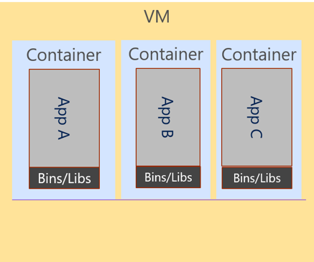
What is a Container Orchestrator?
Cluster
Container Orchestrator

Slide 4
The elements of orchestration
Scheduling
Affinity/anti-affinity
Health monitoring
Failover
Scaling
Networking
Service discovery
Coordinated app upgrades
Kubernetes is a very popular Open Source Container Orchestrator

Slide 5
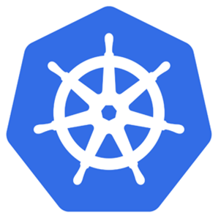
Kubernetes has a Master & Cluster of “Nodes”
Cluster
VM
Master Node
Kubernetes
Guest OS
Hypervisor
Host OS
Server

Slide 6
AKS is Kubernetes (Master) as a Service
Cluster
Kubernetes
Master

Slide 7
Azure Networking Services for Kubernetes Apps
Deploy cluster in a custom VNet
Azure CNI provides access to Vnet resources
Azure Policies provide traffic filtering between Pods
Expose a Kubernetes application behind Azure SLB
Use Azure Firewall to protect Kubernetes applications
Use Application Gateway as Reverse Proxy
Use ExpressRoute or S2S VPN for on-prem access to K8S applications
We will cover many of these services today!

Slide 8
Lab Setup
Every attendee gets a Resource Group named “Company#”
Refer to access card for your company #
Az FW, ER GW, on-prem already deployed and setup
You will run the lab from on-prem server
Over the internet

Slide 9
Account Login & Running the Labs
Portal username/password is for logging into Azure portal: https://portal.azure.com
Lab exercises will be performed from the on-prem server – we will use CLI most of the time
Login, go to your Resource Group and click on KeyVault
KeyVault has 3 user accounts - Use User01. Clicking on it brings up another blade with your password
Use KeyVault username/password to login to the on-prem server
Lab exercises are in separate folders under C:\vdcWorkshop\Documentation\kubernetes
Run a lab from its directory – it also contains config files that you will need in your CLI commands

Slide 10
Lab Exercise 1: Create AKS Cluster
Goal - Create an AKS Cluster in the Spoke Vnet
Use Azure CNI for Pod Networking
Use Azure Policies for Network Policies
Instructions can be found under “Exercise 1 Create Cluster” folder

Slide 11
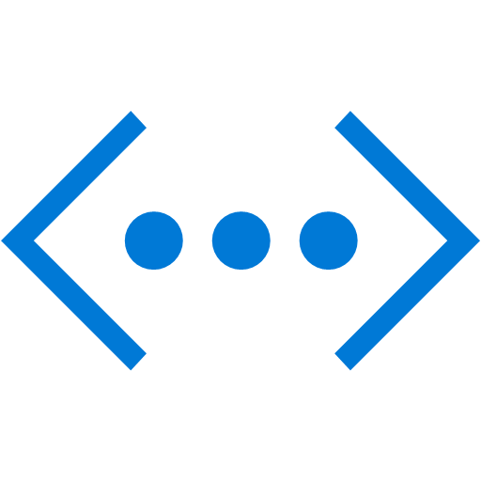


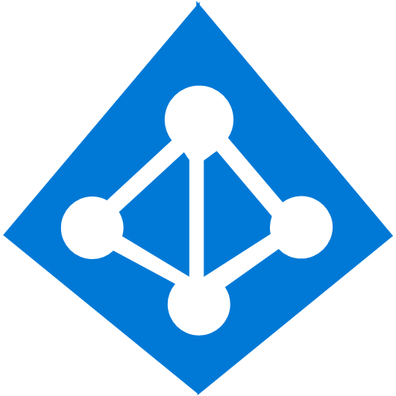
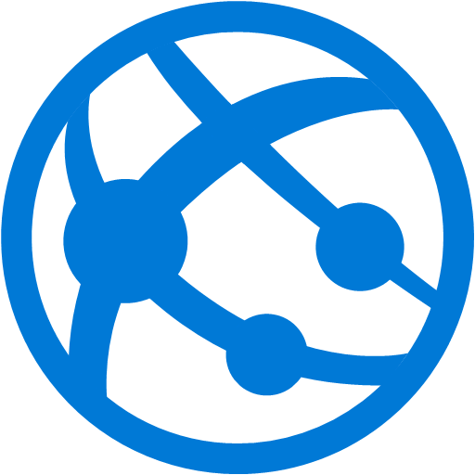

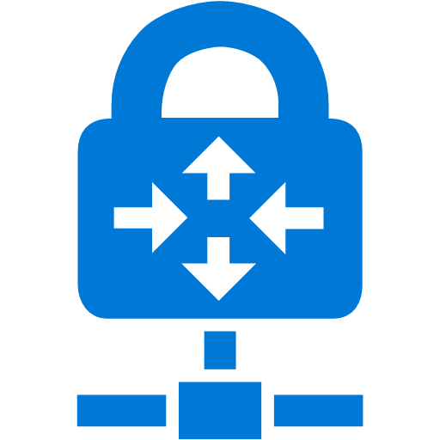


Azure CNI Plugin
Existing VNet
A plugin that installs in every VM
Pods are first class in the VNet
Each Pod has a VNet (routable) IP address
Direct connectivity to VMs, VM Scales sets, ILB
Private connectivity to Injected PaaS services (ASE, AD) and services (Storage, SQL) through Service Endpoints
Connectivity extends to on-premises, peered Vnets
Support for NSG, UDR
Kubernetes networking works seamlessly – K8S Services, DNS, Ingress Controller, Network Policy
Containers
Internet
Peer VNet
Service Endpoints
Azure Services
On-premises
Notes:
Talk about all the vnet capabilities briefly
K8S resources are – services, Ingress controllers etc.

Slide 12
Azure CNI Plugin – A Deeper Look
CNI is a Cloud Native Computing Foundation (CNCF) project that defines the interface between container runtime and underlying network
Azure CNI plugin is a full implementation of the CNI specification with both network driver and IPAM driver
Azure CNI plugin connects the container instances to Azure Virtual Network
Provisions a custom bridge and attaches the ETH0 of the Virutal Machine
Each container instance gets a routable private IP address in the VNet
Supports up to 250 containers/pods per node, 64K/VNet
Open source project in GitHub. Supports CNI version 0.3.1
VNet 10.1/16
NIC
IP0, IP1, IP2, IP3
ETH 0
Azure CNI
IP0
VNet Bridge
VETH
VETH
VETH
C1
C2
C3
IP1
IP2
IP3
Virtual Machine

Slide 13
AKS Limits
Max. 100 nodes/cluster
Max. 110 pods/node – for both Basic and Advanced
Default is 30 for Advanced and 110 for Basic
Not configurable in Portal; configurable in CLI
VNet IP limit is 64K – for both new and existing VNets
For proper IP addr. Management do not deploy VMs in the cluster subnet

Slide 14
Lab Exercise 2: Access VNet Resources from Cluster
Goals
Access a website running on a VM in the hub VNet
Retrieve a blob from a storage account tied to your cluster subnet and protected by Service Endpoints
Instructions can be found under “Exercise2 - Access VNet Resources” folder

Slide 15
Kubernetes Deployment
Deployment
Collection of replicas of an application Pod
Ensures that # replicas is always maintained
# can be scaled manually to more replicas
Can be auto-scaled, mix/max replicas specified
label
app=ratings-web , tier=web
image
azurecr.io/ratings-web:v1
pod
ratings-web-1
port
8080
pod
ratings-web-2
port
8080
ratings-web

Slide 16
Kubernetes Service
Deployment
Exposes a replica of app. Pods on a VIP + Port
Load balances across replicas
Provides port translation based on backend Pod
Yaml file specification used to define the service
label
app=ratings-web, tier=web
image
azurecr.io/ratings-web:v1
Service
pod
ratings-web
port
ratings-web-1
selector
app=ratings-web
port
8080
port
8080:8080
pod
IP
10.0.2.20
ratings-web-2
port
8080
ratings-web

Slide 17
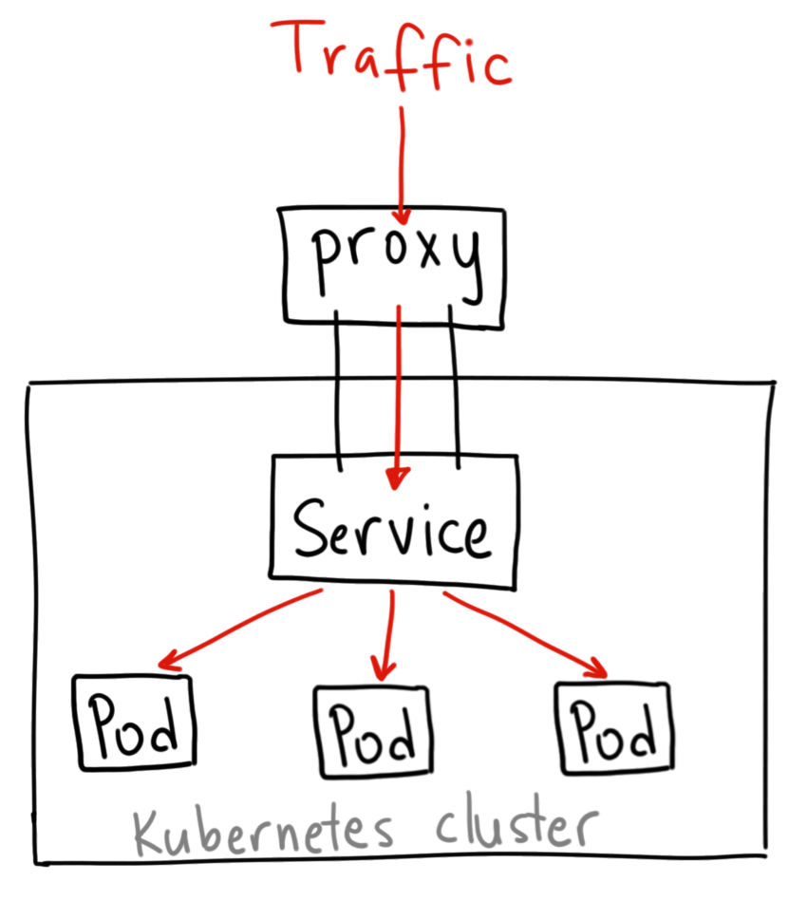
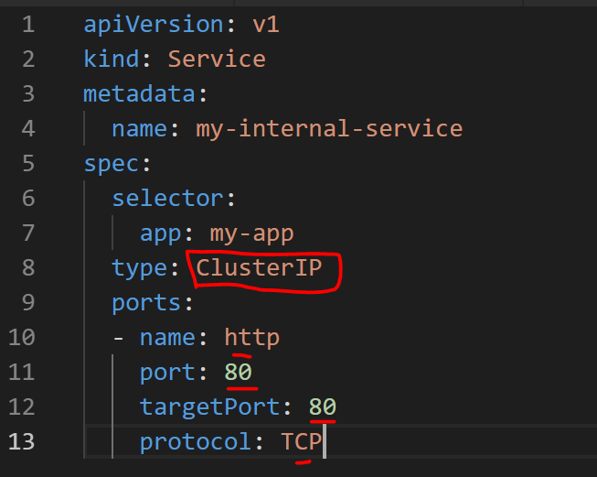
Cluster Service
Exposes an app inside the cluster
VIP accessible only by Pods in the cluster
Traffic is proxied to the backend pods which could be residing on any cluster node
Yaml specification →

Slide 18
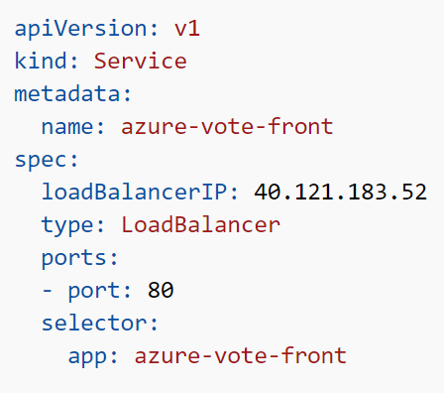
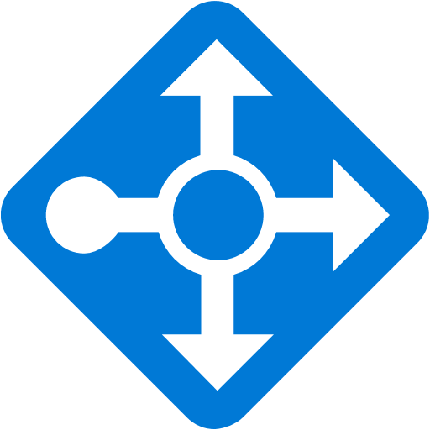


Kubernetes Loadbalancer Service
Exposes a service externally over an ELB/ILB VIP – provides L4 load balancing
Traffic is load balanced to all VMs on a specific port which maps to a service – traffic is then load balanced to services Pods by KubeProxy
LB VIPs can be static or dynamic
Health probes per VM
A VIP for every service but only one LoadBalancer
ExternalTrafficPolicy:Local, preserves client source IP
ExternalTrafficPolicy:Cluster achieves balanced distribution
Azure ARM
Srv. Red: 10.1.1.10/33800
Srv. Blue: 10.1.1.10/33803
Srv. Red: 10.1.1.20/33800
Srv. Blue: 10.1.1.20/33803
Proxy
Proxy
kubectl
Internet
VM1- 10.1.1.10
VM2- 10.1.1.20
K8s Master

Slide 19
Lab Exercise 3: Create Kubernetes Services
Goals
Create a Kubernetes Namespaces – a way to partition your cluster and isolate apps
Create deployments and expose them as Cluster Services
Expose the deployments as Loadbalancer Services
Instructions can be found under “Exercise3 - Create K8S Service” folder

Slide 20
Need for Network Policies for Containers
NSGs secure the infrastructure
Corporate network policies placed on the subnet is applied to container workloads
Microservices need fine grain access control
Containers are dynamic and their IP address changes frequently
Traffic filtering required between containers in the same VM

Slide 21
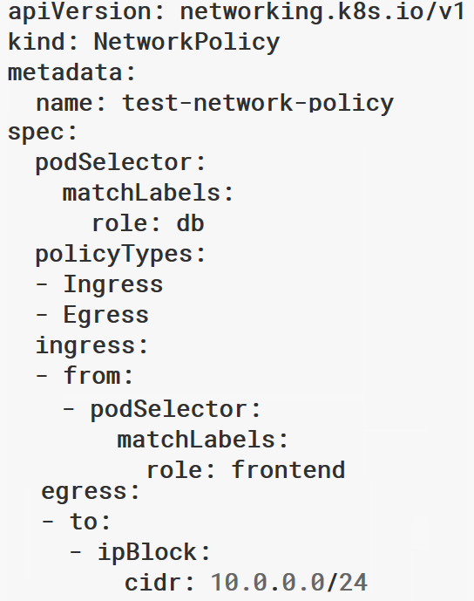
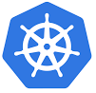
Kubernetes Network Policies
kubectl apply –f policy.yaml
A Kubernetes access policy Specification to filter traffic between Pods
Policy defined in a yaml manifest
Labels used to select Pods for which policies are defined
Ingress/Egress filtering rules defined using Pod Labels, Namespace or IP Block
A Policy solution is an implementation of this specification that listen to the K8S API and enforces the defined policies. Usually runs as a daemonset.
Kubernetes Master
Policy Manager
Policy Manager
Label: Test
Label: Prod
Kubernetes Cluster

Slide 22

Azure Implementation of Network Policies
Existing Virtual Network
Azure Policy plugin is Open Source on GitHub
Uses Linux IPTables to enforce the policies
Rules are translated to allowed/disallowed IP filtering rules
Works with Azure CNI that connects Pods to an L2 Bridge for VNet connectivity
Default policy option in AKS
Supported in aks-engine
Set networkPolicy setting to azure in cluster definition file
Supported for K8S DIY clusters in Azure
Supports Linux hosts
Virtual Machine
Label: Test
Label: Prod
10.1.1.5
10.1.1.6
10.1.1.7
10.1.1.8
Pod
Pod
Pod
Pod
Connects Pods to Bridge
Linux Kernel
iptables
L2 Bridge
Azure CNI
Configures filtering rules
Azure Policy Manager
VM -NIC
10.1.1.2
Kubernetes Cluster

Slide 23
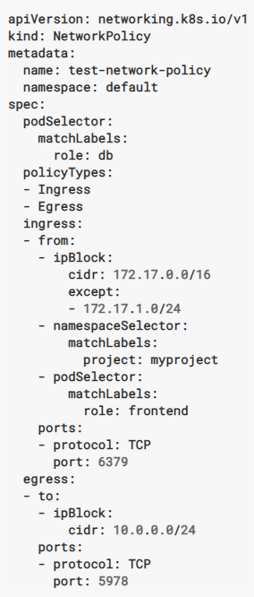
Structure of a Network Policy
Mandatory fields
Label-based selection of Pods in the above-mentioned namespace to which the Policy applies
Indicates whether the policy applies to ingress traffic, egress traffic or both – Ingress always set by default
Set of Ingress rules to allow traffic to the selected Pods
Traffic allowed from endpoints matching one or more of the specified sources on the specified port - IP CIDR range, Pod Namespace, Pod Label
Pod and Namespace selectors can be combined into a single rule by specifying them one after the other – this allows specific Pods in a specific namespace
If Ingress section is absent or empty, then all Ingress traffic is denied
IP CIDR should be sources outside the cluster as Pod IPs are ephemeral
Set of Egress rules that define destinations (and port) to which traffic is allowed from the Pods selected earlier
Notes:
FT list of whitelisted domains is available but not sure if it is thorough

Slide 24
Other Policy Characteristics
If no ingress or egress rules are specified, then traffic to/from the selected Pods is disallowed
You can apply multiple policy yaml files
For Azure Policies, the recommendation is to combine policies for a Pod into one file
Policy can be removed by deleting the policy yaml file
kubectl delete –f policy.yaml

Slide 25
Lab Exercise 4: Kubernetes Policies
Goals
Policy to restrict access to the services from Pods in the same namespace
Exception Policy to allow certain pods in expressroute namespace to access to access firewall-content service
Instructions can be found under “Exercise4 - K8S Policies” folder

Slide 26
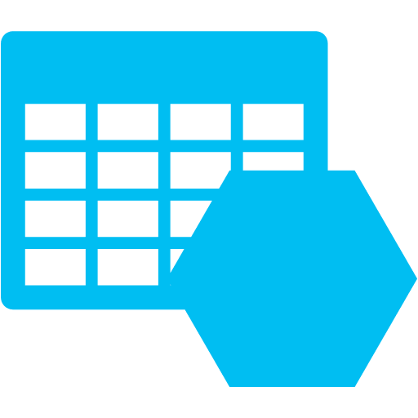


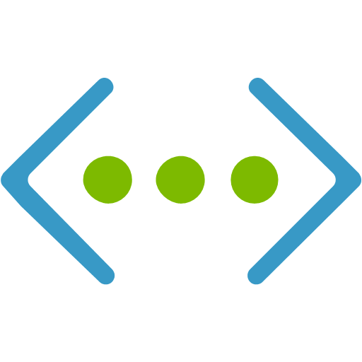




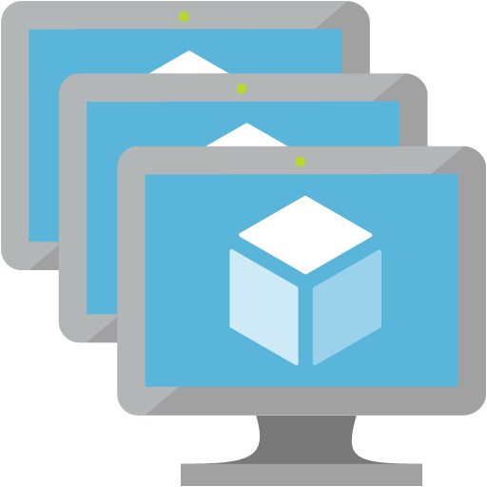
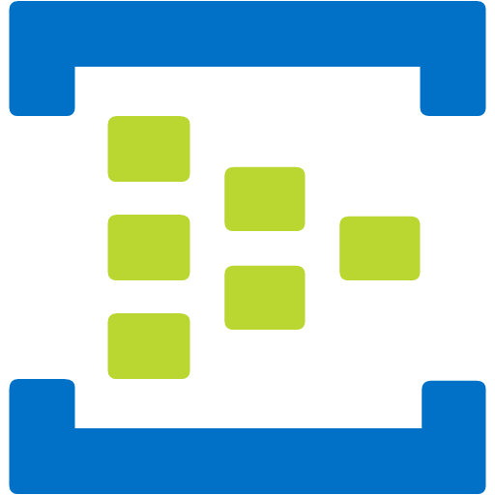


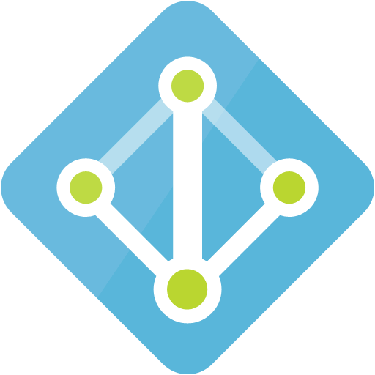




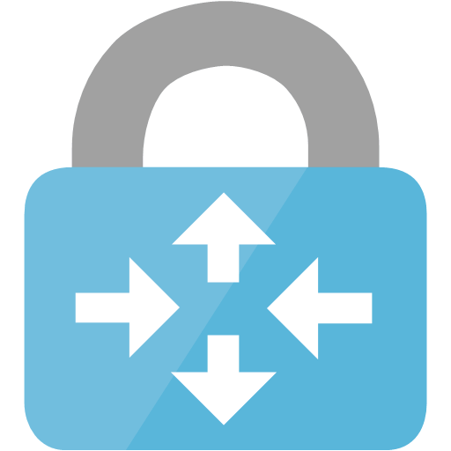
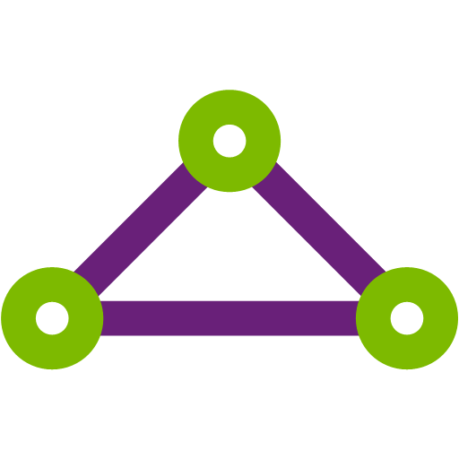


Before/After (Public Access - > Private Access)
Services on Azure
Services on Azure
Azure VNet
Azure VNet
Private IP
Public IPs
Private Endpoint
On-Prem: NATIP
Public IPs
Allow “Service” outbound
Deny “Internet” outbound
On-Prem: NATIP
Deny Internet
ER Private Peering/VPN Tunnel
ER Private Peering/VPN Tunnel
ER Public Peering
On-premises
On-premises

Slide 27

Kubernetes with Private Link
Internet
Kubernetes control
Worker node
kubelet
kube-proxy
Kubernetes users communicate with API server and apply desired state
Master node
Docker
Private
Endpoint
Prod
Prod
API server
Public FQDN
Containers
Containers
Master nodes actively enforce desired state on worker nodes
Today, communication between worker nodes and master nodes using a Public Endpoint (FQDN)
-controller-manager
-scheduler
Private Cluster
Outbound to Internet
Worker node
kubelet
kube-proxy
With Private Link, communication between worker nodes and master nodes using a Private Endpoint
AzFW For Analyzing Outgoing Traffic
replication, namespace, serviceaccounts, etc.
Docker
Prod
Prod
Containers
Containers
Kubernetes
Virtual Network
Customer
Virtual Network
Notes:
Phase 1: A single outbound TCP port 22 tunnel to AKS Destination for the region.
Whitelist Target FQDN:
*.azmk8s.io – http, https (Eg. *eastus.azmk8s.io)
k8s.gcr.io – http, https
storage.googleapis.com - http, https
*auth.docker.io – http, https
*cloudflare.docker.io – http, https
*registry-1.docker.io – http, https NVA or AzFW for Data Ex-Filtration Protection for Egress Traffic to PAAS Services i.e. SQL, Storage, etc…
Phase 2: AKS Cluster Master IP moves to a private IP address (Private-Link), also service endpoints move to private-link. Therefore are no public IPs. Also remove external dependencies by pulling required container images into Az Container Registry, allowing us to remove those FQDNs.

Slide 28
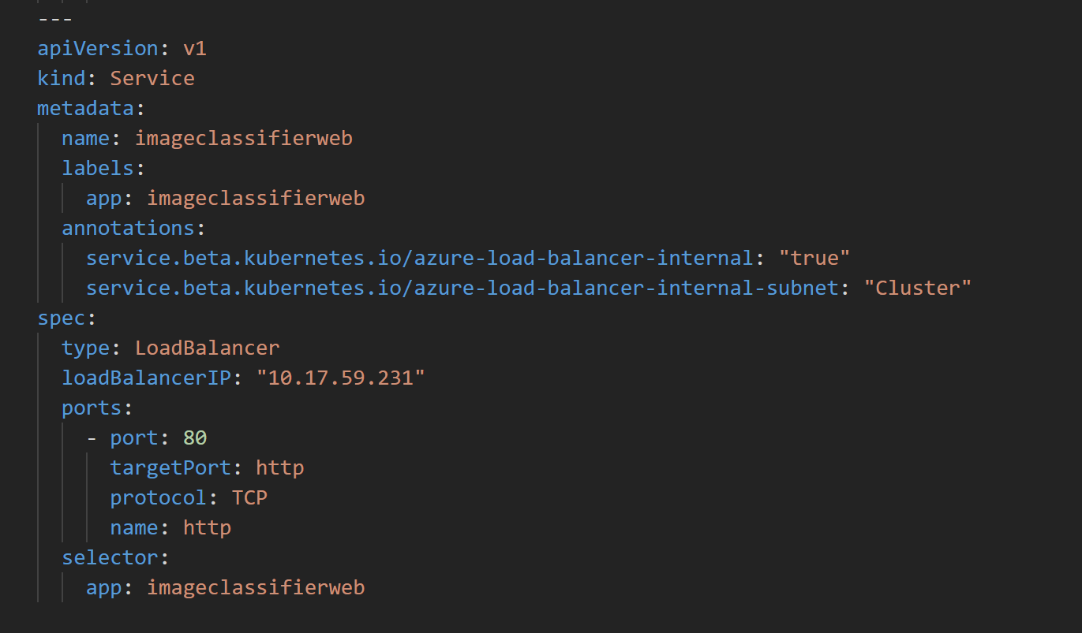


L7 Load Balancing – Ingress Controller
color.contoso.com/red
Kubectl
Azure FW
Ingress
Controller
Kubernetes Master
color.contoso.com/blue
Public IP
Ingress
/red: K8S Service S1
Private IP
Reverse Proxy
Traffic Routing
TLS Termination
/blue: S2
Azure
SLB
/shades.contoso.com: S3
Provides reverse proxy, URI-based traffic routing on single VIP, TLS termination
Exposes a service outside the cluster – to Vnet or Internet
Ingress itself is a K8S service of type Load Balancer
K8S ingress resource yaml is used to specify routing rules for services
AKS Recommends two Ingress Controller Solutions
NGINX
HTTP Application Routing –
Automatically deploys Ingress Controller
Creates DNS Zone in Az DNS, publicly accessible name for the application endpoint – uses External DNS Controller
Notes:
IC – can specify TLS configuration. Uses only a default load balancing algorithm supported by all Ics. No way to specify the load balancing algorithm in the

Slide 29
Egress Filtering: Azure Firewall
L3-L7 Connectivity Policies
Egress Traffic from pods sent through Azure Firewall using UDRs
Azure Firewall gives centralized security control, logging
Support L7 filtering policies such as FQDN filtering
NAT, Network and Application traffic filtering rules allows Inbound/Outbound access
VNet
Central VNet
Azure FW
AKS subnet
UDR
Destination | Next hop
<publicip> | Internet
0.0.0.0/0 | Azure FW
Traffic is denied by default

Slide 30
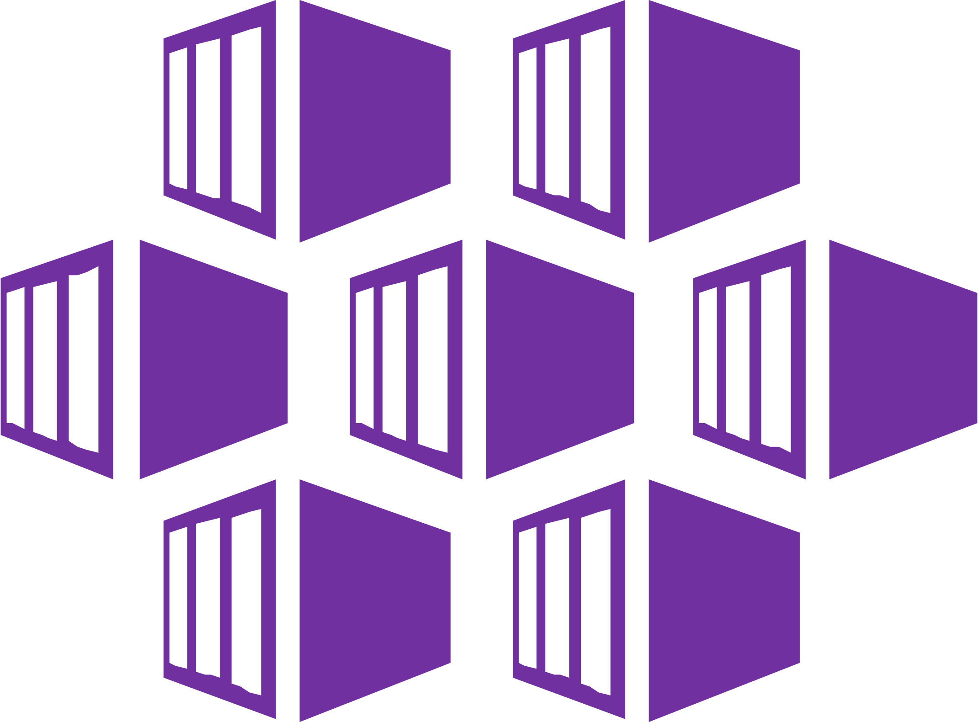

Ingress Controller: Azure Application Gateway
Application Gateway Ingress Controller
Deployed using Helm.
Associates existing Application Gateways with AKS clusters.
Supports:
TLS
Multi-site configurations
path-based routing
https://github.com/Azure/application-gateway-kubernetes-ingress
Azure Kubernetes Service (AKS)
Azure Application Gateway
API server
Ingress Resource
Internet
Application Gateway Routing Rules
Application Gateway Ingress Controller
Azure ARM
Notes:
Azure Firewall is a fully stateful firewall as a service offering that enables centralized policy enforcement across multiple vnets and subscriptions. Customers can create network and application filtering policies to protect their assets. L3-L4 policies are 5-tuple based while application policies restrict access to specified list of FQDNs. Integration with Azure Monitor simplifies compliance through central logging and monitoring capabilities. Built-in HA and scalability helps our customers focus more on their security requirements. Can be integrated with ER and VPN gateways to extend support to hybrid networks.
Azure Firewall uses public IP for all traffic from the VNet traversing the internet, enabling simplified IP based ACLs to identify traffic from the Vnet. Servers that need to be accessed via the internet can leverage DNAT support to forward traffic bound to public ip, port and protocol.

Slide 31
Backup

Slide 32
Networking Options in AKS
Basic (KubeNet)
Advanced (Azure CNI)
AKS cluster
AKS cluster
VM1 (10.1.1.4)
VM2 (10.1.1.5)
VM1 (10.1.1.4)
VM2 (10.1.2.4)
192.168.1.4
192.168.1.5
192.168.2.4
192.168.2.5
10.1.1.5
CNI
10.1.2.6
CNI
10.1.1.6
10.1.2.5
Cluster deployed in a separate VNet
Pods assigned IPs from a separate CIDR space of size > /24; each node allotted a /24
UDRs used to connect Pods
Traffic outside Pod CIDR range is SNATed to VM IP
Cluster can be deployed in custom VNet
Azure CNI plugin present in every Kubernetes node
Pods directly attached to the VNet
Direct connectivity between Pods
Traffic outside VNet range is SNATed to VM IP
Dest | Next Hop
192.168.1.0/24 | 10.1.14
192.168.2.0/24 | 10.1.1.5
S: 10.1.1.5
D: 10.2.1.10
S: 10.1.1.4
D: 10.2.1.10
S: 192.168.1.4
D: 10.1.1.10
S: 10.1.1.4
D: 10.1.1.10

Slide 33
KubeNet Exception
KubeNet allows cluster to be deployed into custom VNet through CLI
However, UDRs for Pod-Pod communication must be applied manually by customer
Route table is created but AKS today doesn’t have the permissions to apply it to customer VNet
New routes added to table during scale-out are automatically applied
Documentation for this scenario was added recently …
https://docs.microsoft.com/en-us/azure/aks/configure-kubenet

Slide 34
Capabilities - Basic vs. Advanced
Capability | Basic Networking | Advanced Networking
Deploying cluster in existing and new Vnet | Supported – UDRs to be applied manually | Supported
Pod-Pod connectivity | Supported | Supported
Pod-VM connectivity; VM in the same VNet | Works when initiated by Pod | Works both ways
Pod-VM connectivity; VM in peered VNet | Works when initiated by Pod | Works both ways
On-premises access, over VPN/ER | Works when initiated by Pod | Works both ways
Access to resources secured by service endpoints | Supported | Supported
Exposing K8S service as an LB service; AppGW; Ingress Controller | Supported | Supported
DNS – Default Az DNS and Private Zone DNS | Supported | Supported
Basic Conserves IP space K8S ELB/ILB service to reach Pods from outside cluster Need to manage and maintain UDRs Limited to 400 node clusters Perf impact when there is lots of outgoing traffic | Advanced Pods get full VNet connectivity and are directly reachable from outside cluster Need more VNet IPs

Slide 35
When to Use - Basic vs. Advanced
Use Basic when
Limited VNet IP space
Most communication is within the cluster
Integrating with existing VNets is not a priority
Use Advanced when
Need Vnet integration
Have VNet IP space
Lot of communication to resources outside the cluster
Don’t want to manage UDRs

